Slide 1
A Style-Based
Generator Architecture for GAN
10/01/19

Slide 2
Introduction
A StyleGAN generates the artificial image gradually starting from a very low resolution and continuing to a high resolution (1024 * 1024)
Now Generators continue to operate as black boxes, and despite recent efforts, the understanding of various aspects of the image synthesis process, e.g., the origin of stochastic features, is still lacking.

Slide 3
Introduction
By modifying the input of each level separately, it controls the visual features that are expressed in that level, from coarse features like pose, face shape to fine details like hair color without affecting other levels.
Combined with noise injected directly into the network, this architectural change leads to automatic, unsupervised separation of high-level attributes (pose, identity) from stochastic variation (freckles, hair) in the generated images, and enables intuitive scale-specific mixing and interpolation operations

Slide 4
Properties of StyleGan
Style-Mixing
Stochastic variation
Separation of global effects from stochasticity

Slide 5
Style Mixing
When generating an image, we simply switch from one latent code to another an operation we refer to as style mixing at a randomly selected point in the synthesis network.
To be specific, we run two latent codes z1, z2 through the mapping network, and have the corresponding w1, w2 control the styles so that w1 applies before the crossover point and w2 after it. This regularization technique prevents the network from assuming that adjacent styles are correlated.

Slide 6
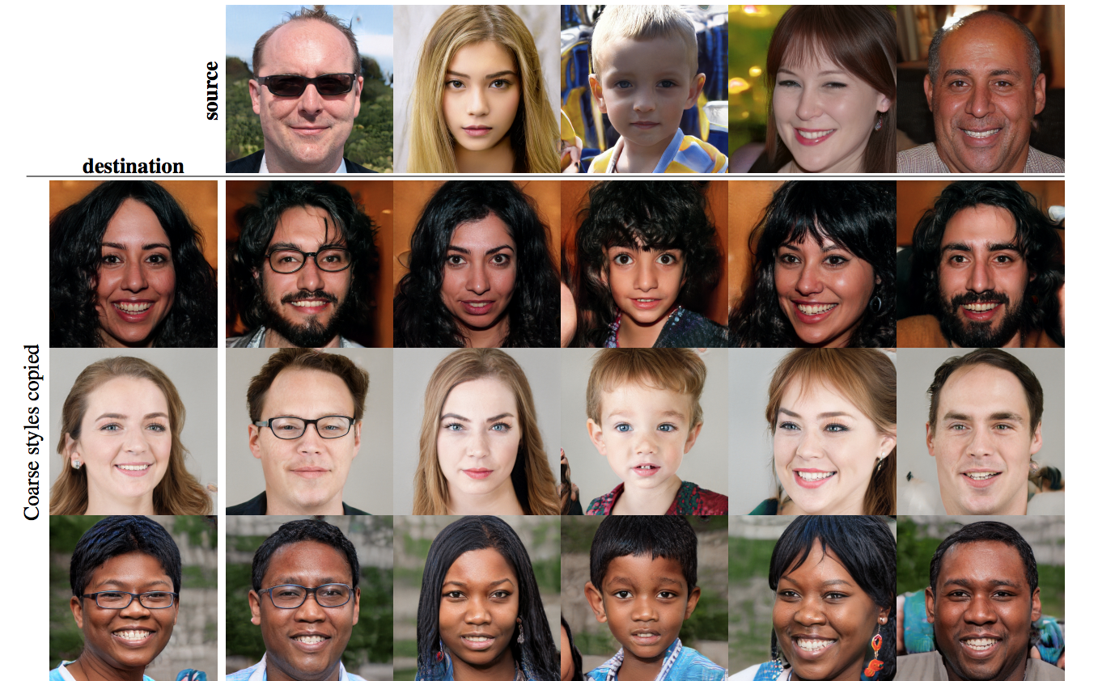

Slide 7
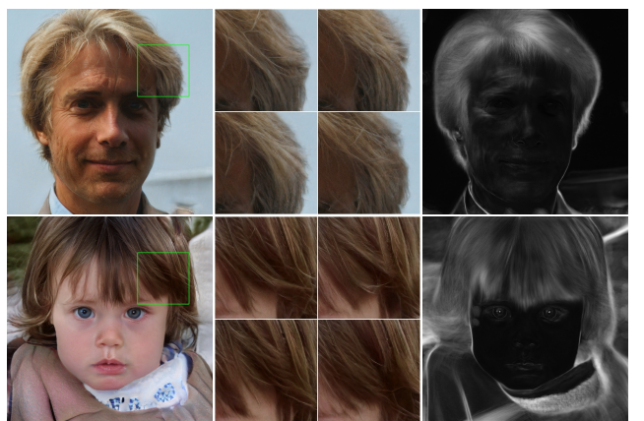
Stochastic variation
There are many aspects in human portraits that can be regarded as stochastic, such as the exact placement of hairs, stubble, freckles or skin pores.

Slide 8
Separation of global effects from stochasticity
In StyleGan, the style affects the entire image because complete feature maps are scaled and biased with the same values.
Therefore, global effects such as pose, lighting, or background style can be controlled coherently. Meanwhile, the noise is added independently to each pixel and is thus ideally suited for controlling stochastic variation.
If the network tried to control, e.g., pose using the noise, that would lead to spatially inconsistent decisions that would then be penalized by the discriminator

Slide 9
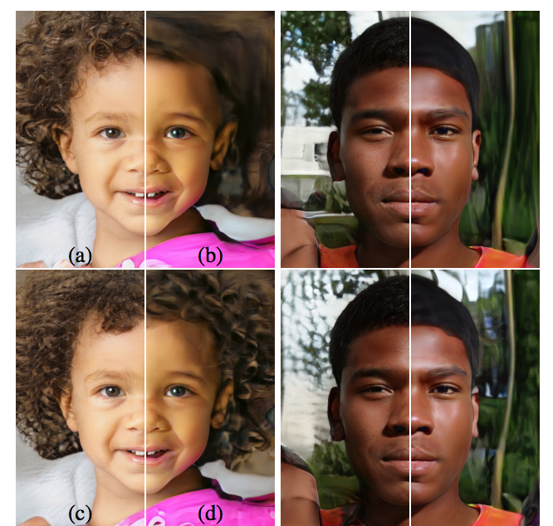
Effect of noise inputs at different layers of our generator. (a) Noise is applied to all layers. (b) No noise. (c) Noise in fine layers only (d) Noise in coarse layers only. We can see that the artificial omission of noise leads to featureless “painterly” look. Coarse noise causes large-scale curling of hair and appearance of larger background features, while the fine noise brings out the finer curls of hair, finer background detail, and skin pores.

Slide 10
Reference
StyleGAN
https://mc.ai/explained-a-style-based-generator-architecture-for-gans-generating-and-tuning-realistic/

Slide 11
Thank You

